Slide 1
Vehicle price calculator
Recurrent neural network
By Brian Kilburn, Jamie Weiss, and dominic holt

Slide 2
Rnn recap
A recurrent neural network (RNN) is a class of artificial neural network where connections between nodes form a directed graph along a sequence. This allows it to exhibit temporal dynamic behavior for a time sequence. Unlike feedforward neural networks, RNNs can use their internal state (memory) to process sequences of inputs. This makes them applicable to tasks such as unsegmented, connected handwriting recognition or speech recognition.

Slide 3
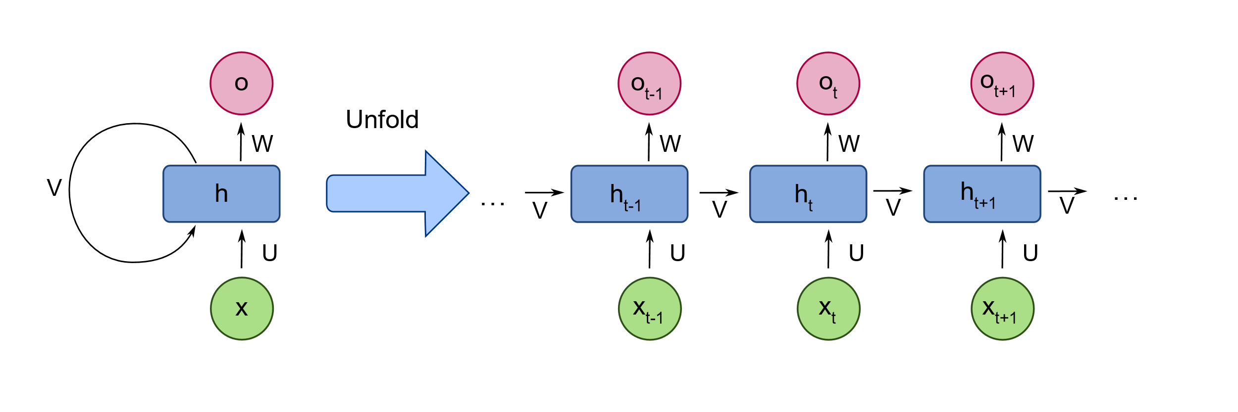
Rnn recap

Slide 4
Activation function
TAHN - is mainly used for classification between two classes. Both Tahn and Sigmoid functions
are used in feed-forward networks.

Slide 5
Activation function
TAHN - is mainly used for classification between two classes. Both Tahn and Sigmoid functions are used in feed-forward networks.
RELU - We learned in class.

Slide 6
Activation function
TAHN - is mainly used for classification between two classes. Both Tahn and Sigmoid functions are used in feed-forward networks.
RELU - We learned in class.
SELU - (Scaled Exponential Linear Units)

Slide 7
Selu (scaled exponential linear units)
keep the outputs normalized

Slide 8
Selu (scaled exponential linear units)
keep the outputs normalized
Batch normalization not required

Slide 9
Selu (scaled exponential linear units)
keep the outputs normalized
the normalization occurs inside the activation function.

Slide 10
Selu (scaled exponential linear units)
keep the outputs normalized
the normalization occurs inside the activation function.
A custom weight initialization technique is being used.

Slide 11
Selu (scaled exponential linear units)
keep the outputs normalized
the normalization occurs inside the activation function.
A custom weight initialization technique is being used.
Removes the Vanishing/exploding gradient Problem

Slide 12

Selu (scaled exponential linear units)

Slide 13
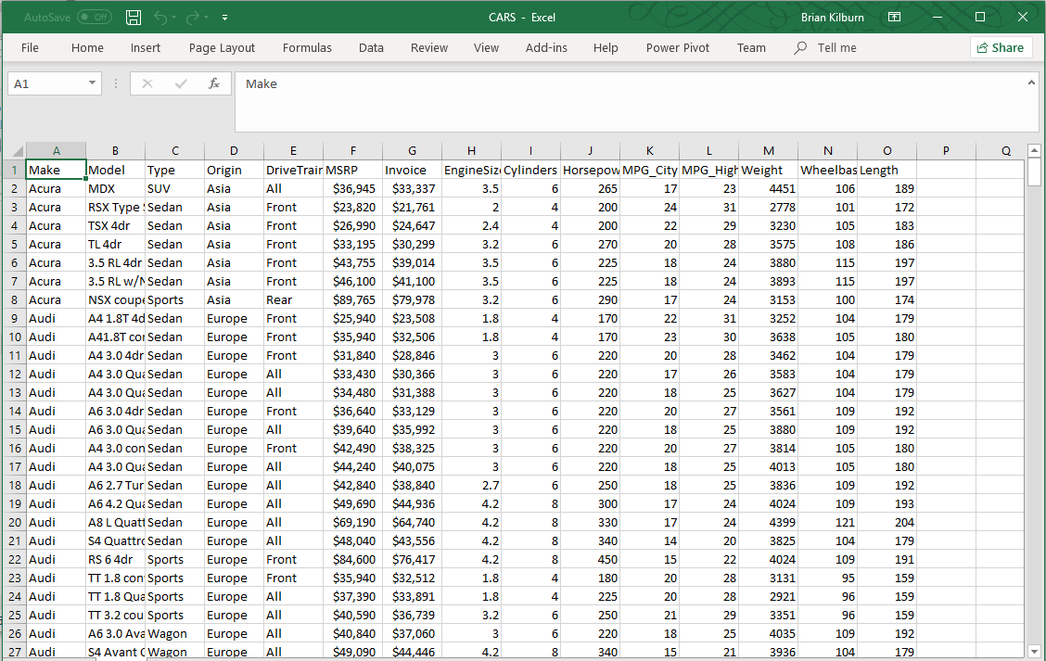
Formatting data

Slide 14
Formatting data
One Hot Encoding for categorical data

Slide 15
Formatting data
One Hot Encoding for categorical data
Pandas

Slide 16
Formatting data
One Hot Encoding for categorical data
Convert the MSRP column to type float32 and removed special characters

Slide 17
Biggest challenge
Feeding the tensorflow graph

Slide 18
Biggest challenge
Feeding the tensorflow graph
SNN
Batches (train_x, train_y) , (test_x, test_y)

Slide 19
Biggest challenge
Feeding the tensorflow graph
SNN
Batches (train_x, train_y) , (test_x, test_y)
Shape the tensor correctly
x = tf.placeholder('float32', [None, n_input]) # (?, 445)
y = tf.placeholder('float32', [n_classes]) # (410)

Slide 20
Biggest challenge
Feeding the tensorflow graph
SNN
Batches (train_x, train_y) , (test_x, test_y)
Shape the tensor correctly
x = tf.placeholder('float32', [None, n_input]) # (?, 445)
y = tf.placeholder('float32’, [None, n_classes]) # (?, 410)
Labels were categorical, feeding 410 rows that were supposed to be columns.

Slide 21
Biggest challenge
Feeding the tensorflow graph
SNN
RNN
One Hot encoded everything!

Slide 22
Biggest challenge
Feeding the tensorflow graph
SNN
RNN
One Hot encoded everything minus the labels which were still converted to float!
Items need to be fed in sequence (sequential data)
x_test.reshape(-1,x_test.shape[1],1) # (428,1072,1)

Slide 23
Biggest challenge
Feeding the tensorflow graph
SNN
RNN
One Hot encoded everything!
Items need to be fed in sequence (sequential data)
Learns from previous state

Slide 24
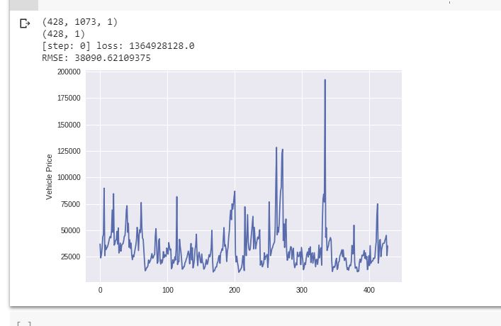
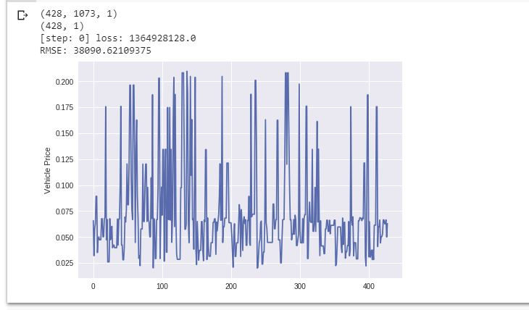
Results
*y test – how our data should have looked
*actual results from our program

Slide 25
Conclusion
Results not what we expected
Likely cause – not enough data

Slide 26
References
https://en.wikipedia.org/wiki/Recurrent_neural_network
https://towardsdatascience.com/activation-functions-neural-networks-1cbd9f8d91d6
https://towardsdatascience.com/selu-make-fnns-great-again-snn-8d61526802a9
https://arxiv.org/ftp/arxiv/papers/1810/1810.08650.pdf

